Slide 1
Why Take Healing Hearts Express?
Heal the Man, Heal the Land
Parts 1 and 2

Slide 3
Healing Hearts Express is about reconciling areas of brokenness in your heart with your mother and father

Slide 4
The Domino Effect

Slide 5
The Cornelius Effect
Acts 10:1-48

Slide 6
What you allow God to do in your heart this weekend will affect your children and grandchildren

Slide 7
Kris Valloton’s Open Vision

Slide 9
Elijah Must Come First!

Slide 10
And His disciples asked Him,
“Why then do the scribes say that
Elijah must come first?”
And He answered and said,
“Elijah does come and restores all things.”
Matthew 17:10-11 ESV

Slide 11
What needs to be restored?

Slide 13
Unresolved childhood pain will negatively affect your family
and future generations

Slide 14
Unresolved childhood trauma can also negatively impact a community, city and nation

Slide 15
“Behold, I am going to send you Elijah the prophet
before the coming of the great and terrible day of the Lord. He will turn the hearts
of the fathers back to children and the hearts of the children
to their fathers, so that I will not come and strike the land with complete destruction.”
Malachi 4:5-6 NASB

Slide 16
Our Nation is Being Destroyed by…
Inflation
Woke teachings
Political upheaval
Rampant violence
Unsecured borders
Mass school shootings

Slide 17
Family restoration begins with parents asking their children to forgive them for intentionally or unintentionally wounding them

Slide 18
Family restoration continues with you and I forgiving our parents for the ways they have hurt us

Slide 19
Luke 1:16-17 TPT
“And he will persuade many in Israel to convert
and turn back to the Lord their God.
He will go before the Lord as a forerunner,
with the same power and anointing as Elijah the prophet.
He will be instrumental in turning the hearts of the
fathers in tenderness back to their children and
the hearts of the disobedient back to the wisdom
of their righteous fathers. And he will prepare a united
people who are ready for the Lord’s appearing.”

Slide 20
“John himself will go ahead of the Lord and make people ready for his coming.
He will be powerful like Elijah and will have the same spirit.
He will make peace between fathers and their children.
He will cause people who are not obeying God to change and start thinking the way they should.”
Luke 1:16-17 ERV

Slide 21
There is nothing more important than the emotional health of our families

Slide 22
Adverse Childhood Experiences

Slide 23
“Adverse childhood experiences are the single greatest unaddressed health threat facing our nation today.”
Dr. Robert Black, the former president of the American Academy of Pediatrics

Slide 24
What are ACEs?

Slide 25
Traumatic events that can have a negative, lasting effect on our health & emotional well being

Slide 26
Abuse
Emotional
Physical
Sexual

Slide 27
Household Challenges
Mental Illness
Substance abuse
Domestic Violence
An Incarcerated Parent
Parental Separation/Divorce

Slide 28
Neglect
Emotional
Physical

Slide 29
67%
of the people in our nation have had at least one adverse childhood experience

Slide 30
1/8 of our population has had 4 adverse childhood experiences

Slide 31
People with 6 or more ACEs in our country die 20 years earlier than those who have had none

Slide 32
acestoohigh.com

Slide 33
The Unseen Scars of Childhood
(Key Questions that Expose ACEs)

Slide 34
Did an adult or person at least 5 years or older ever touch you in a sexual way or try to make you touch their body or have sex with you?

Slide 35
Before you were 18 did a parent or family member ever swear, insult or put you down?

Slide 36
Did your parents or other adult family members ever slap, hit, kick or beat each other up?

Slide 37
Did your parents or other adult family members drink heavily, use drugs or abuse prescription medications?

Slide 38
Were either of your parents hyper religious, legalistic or extremely rule oriented?

Slide 39
Did either of your parents deal with PTSD as the consequence of experiencing violence or war?

Slide 40
Did your parents neglect you by not feeding or caring for your basic needs?

Slide 41
Was either of your parents depressed or mentally ill?

Slide 42
Did either of your parents die before your were eighteen?

Slide 43
Did a member of your family or household ever go to prison?

Slide 44
If you answered yes to any of these questions you had an adverse childhood experience

Slide 45
The Orphan Stronghold

Slide 46
What is a stronghold?

Slide 47
A stronghold is a mindset filled with bitterness, fear and control that has a ‘strong-hold’ on the way you function as a person

Slide 48
Strongholds are filled with hopeless ness leading you to conclude that you, your circumstances or behavior cannot change

Slide 49
Healing Hearts is about dismantling the orphan mindsets that affect your identity and behavior

Slide 51
An Orphaned Child
We all long to be loved

Slide 52
Three Objectives
Share any orphan mindsets you’re presently struggling with
Identify a painful childhood memory (ACE) and pencil it onto your worksheet
Allow your small group facilitators to ask you for forgiveness for hurting you (the painful memory)

Slide 53
Prayer to Soften A Stony Heart

Slide 54
Small Group Time
Healing begins w/revealing

Slide 55
Next Session

Slide 56
John 14:18

Slide 57
Bereaved
Comfortless ness
Unresolved Pain

Slide 58
Adam and Eve: The 1st Orphans
(From Love to Fear & Shame)

Slide 59
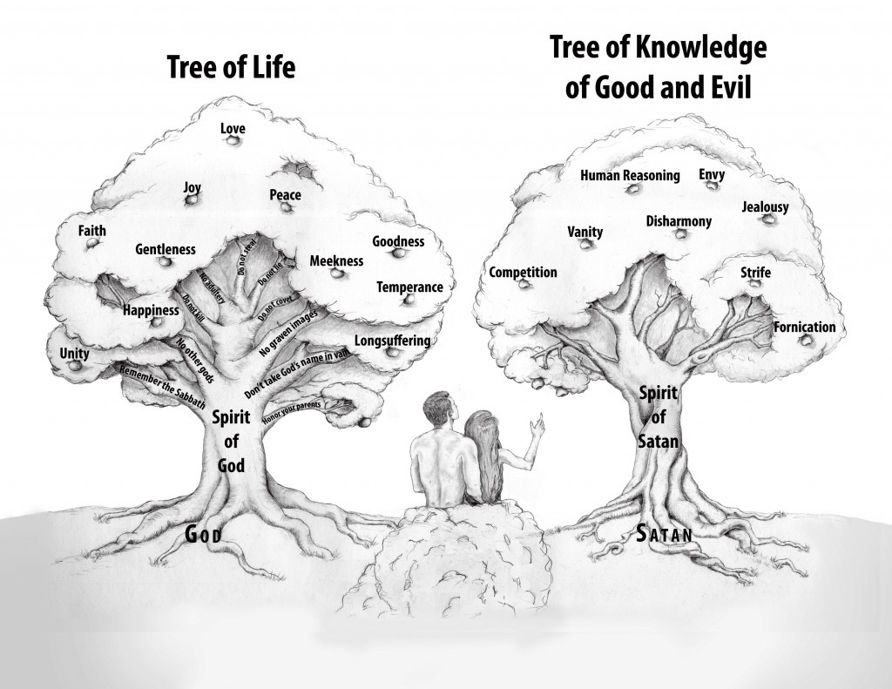

Slide 60
Because of the Fall your parents parented you from the wrong tree

Slide 61
Human Reasoning, Logic etc.
Be Not Wise in Your Own Eyes

Slide 62
The Anatomy of a Stronghold

Slide 63
Mindsets impregnated with hopelessness

Slide 64
Orphan Mindsets/Lies
(Pain and Discomfort)
I am all alone
I am messed up
I am a bad person

Slide 65
God doesn’t love me
No one cares about me
My feelings don’t matter
I don’t belong in God’s family
No one wants to be my friend

Slide 66
There is no such thing as a happy family
Even when I do my best it’s not good enough
I am not worthy to receive from God

Slide 67
I am valuable to others only for what I can do for them
The best way to avoid hurt is to isolate myself from others
Significant people in my life will not be here for me when I need them

Slide 68
Orphan Characteristics
They don’t trust authority figures
They get easily offended or rejected
They are often lonely, afraid and insecure

Slide 69
They sometimes use others for self-gain
They don’t believe they have a positive future
They are unable to put down roots in a church family

Slide 70
They have a survivalist outlook
They are fiercely independent
They struggle to overcome challenges and conflict

Slide 71
They withdraw or leave when they get hurt or offended
They are uncomfortable around anointed father figures
They believe they have to project a false image of themselves to be accepted

Slide 72
How do we get orphaned?

Slide 73
Because our parents misrepresented the Father and Mother heart of God

Slide 74
“For I have come to you representing my Father,
and you refuse to welcome me, even though you
readily accept others who represent only themselves.”
John 5:43 (TLB)

Slide 75
Philip said to him, “Lord, show us the Father,
and it is enough for us.”
Jesus said to him, “Have I been with you so long,
and you still do not know me, Philip?
Whoever has seen me has seen the Father.
How can you say, ‘Show us the Father’?
John 14:8-9

Slide 76
The primary calling of every parent is to reveal God

Slide 77
Because of the Fall every parent has parented their children from the wrong tree

Slide 78
Orphan parents reproduce orphan children

Slide 79
Mother-Father Types
Parental Misrepresentations
The Absent Parent
The Abusive Parent
The Authoritarian Parent

Slide 80
The Good Parent
The Passive Parent
The Performance Oriented Father

Slide 81
The Absent Father
Characteristics and Lie
Not around because of workaholism
Not around because of divorce or separation
The Lie: The Father will not be here for me when I need Him

Slide 82
The Abusive Parent
Characteristics and the Lie
Physical, sexual or verbally abusive
Creates an ‘walking on egg shells’ environment
The Lie: It is my fault that mom or dad is abusive

Slide 83
The Authoritarian Parent
Characteristics and the Lie
It’s my way or the highway!
Anal, legalistic and rule oriented
The Lie: God is all about the rules (religiousity)

Slide 84
The Good Parent
Characteristics and the Lie
Good is not divine perfection
My parents did not hurt me etc.
The Lie: I do not have any issues

Slide 85
The Passive Parent
Characteristics and the Lie
They don’t speak much to their children
Passive dads abdicate their leadership role
The Lie: God doesn’t speak to me/I can’t hear Him

Slide 86
The Performance Oriented Parent
Characteristics and the Lie
Love and affirmation are given only when their children perform well
Performance oriented children deal w/burnout & depression later in life
The Lie: If I don’t excel according to my standard of excellence I’m a failure

Slide 87
The Father is a Perfect Parent
Characteristics
The Father is always present
The Father is kind and merciful
The Father is about relationship not the rules

Slide 88
The Father is perfectly good at all times for those who trust Him
The Father constantly speaks to His children via His Word, dreams etc.
The Father is pleased with who we are not with what we can do for Him

Slide 90
Parental Types
Review
Absent
Abusive
Authoritarian
Good
Passive
Performance Oriented

Slide 91
Small Group Time
Share what type of parents you have & how they wounded your heart

