Slide 1
Praying for Elements and DNA

Slide 2
Elements

Slide 3
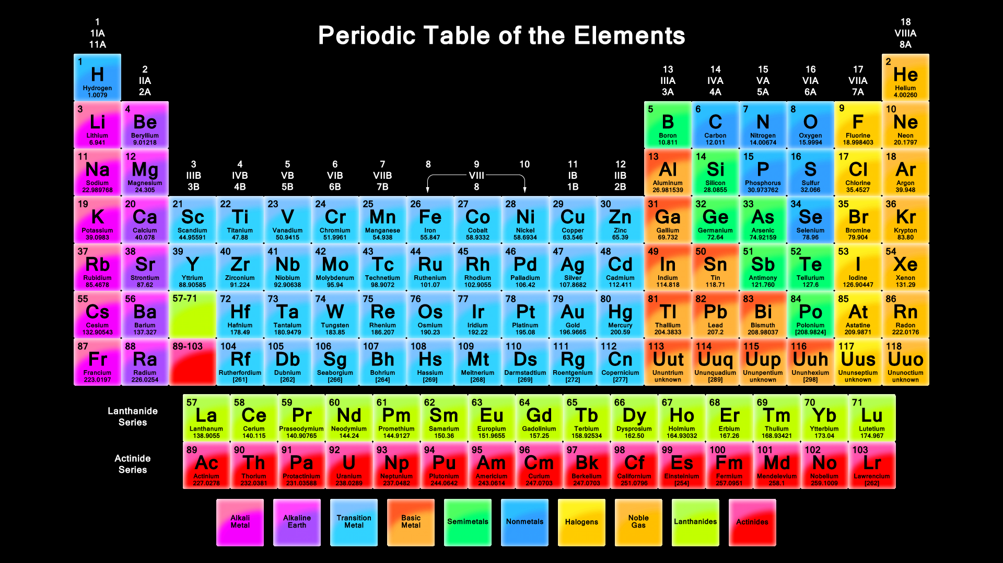

Slide 4
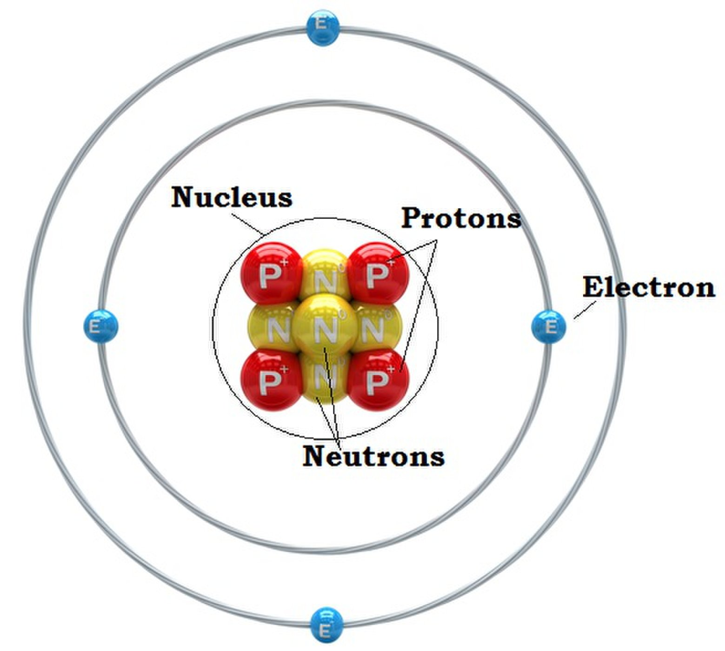
beryllium atom

Slide 5
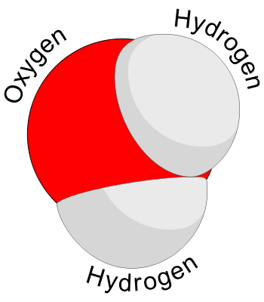
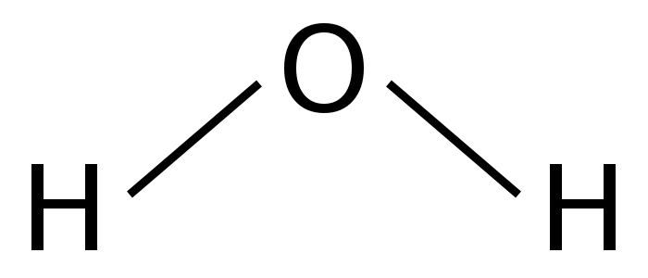
Water Molecule

Slide 6
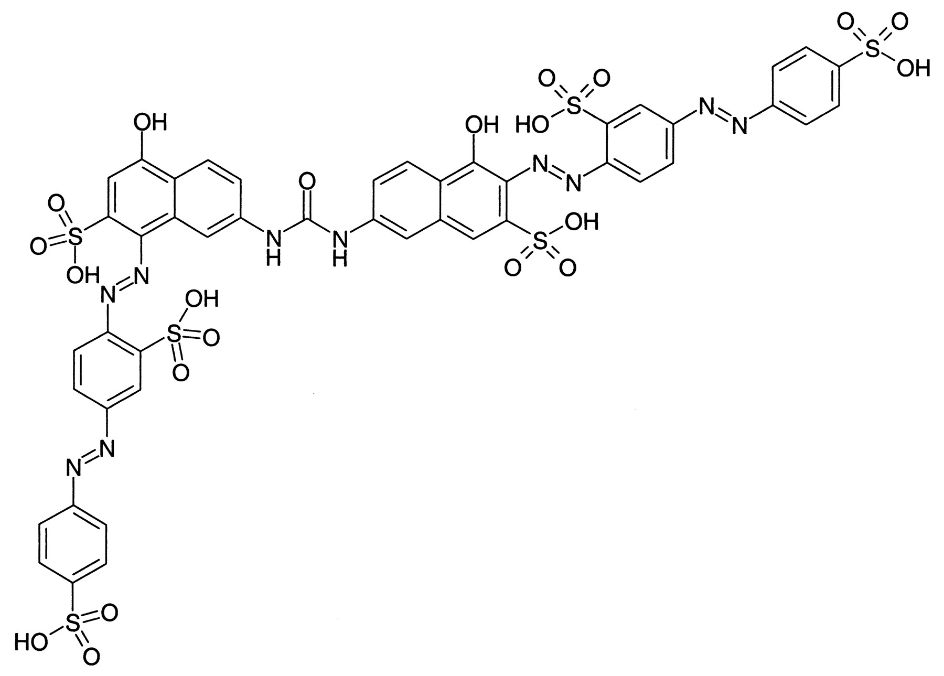
Insulin Molecule

Slide 8
DNA

Slide 9
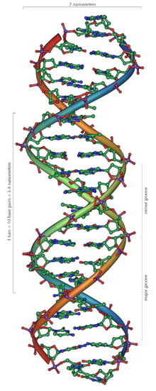
DNA Molecule

Slide 10
ACGT
Nucleotides are a kind of organic molecule.
DNA uses four nucleotide bases,
they form base pairs:
A – adenine
C – cytosine
G - guanine
T - thymine

Slide 11
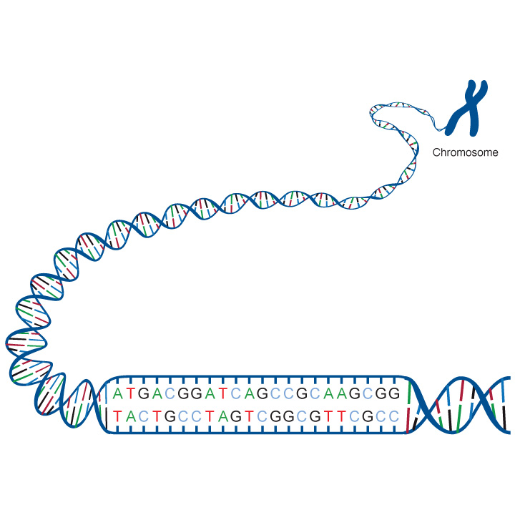
The sequence of bases in a portion of a DNA molecule,
called a gene,
carries the instructions needed to assemble a protein.

Slide 12
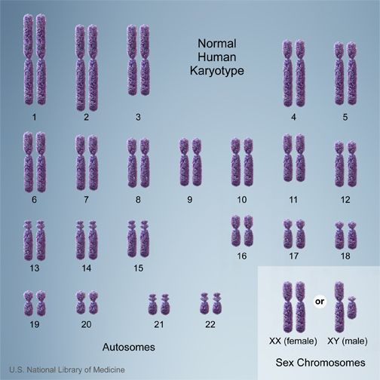
Human Chromosomes

Slide 13
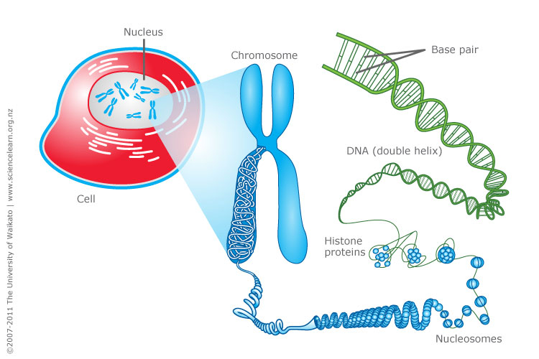

Slide 14
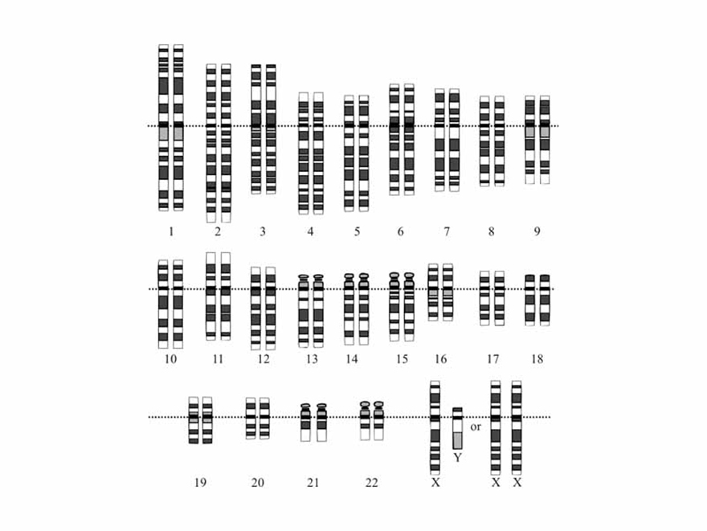
Human Karyotype

Slide 15
Cytogenic Location for CFTR Gene
7q31.2
Notes:
CFTR gene
cystic fibrosis transmembrane conductance regulator

Slide 16
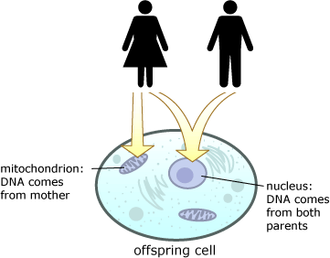
Mitochondria DNA

Slide 17
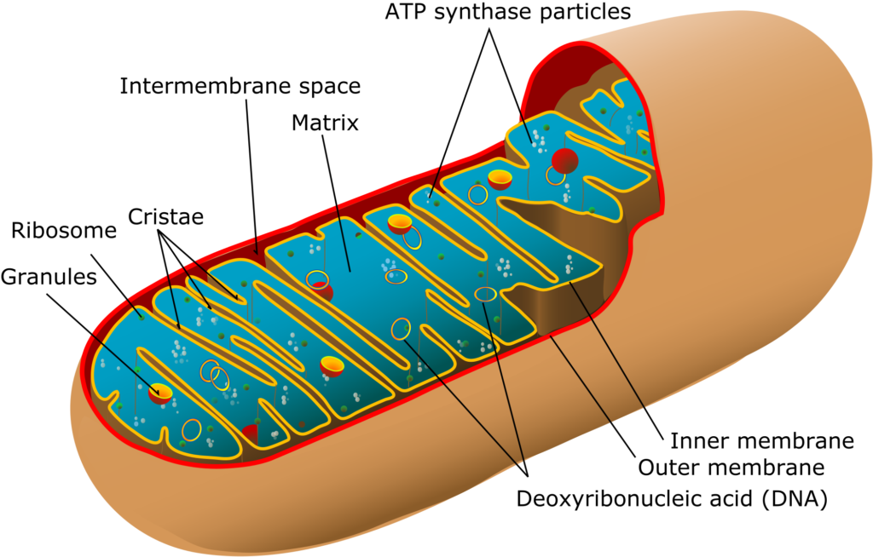
Mitochondrion

Slide 18
Mitochondria DNA

Slide 19
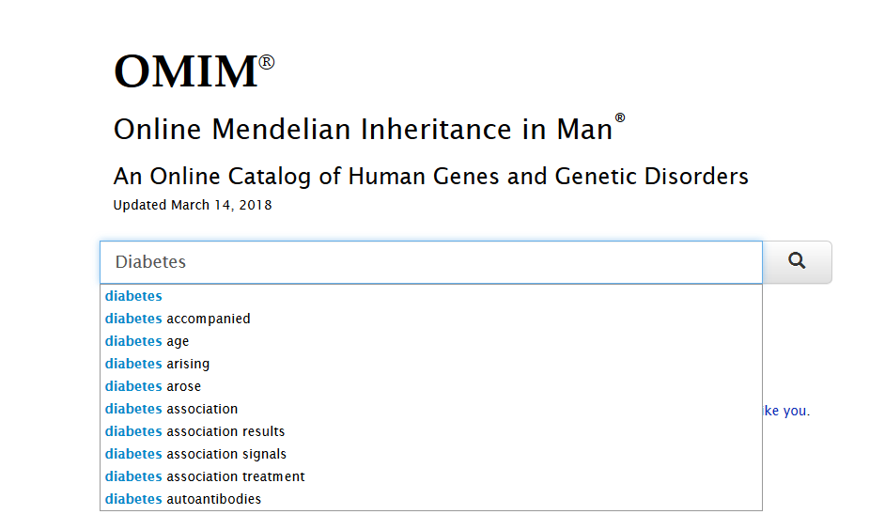
Searching for issues in the chromosomes
www.omim.org

